Slide 1
Motif enhanced ensemble network inference prediction
Rick Reijnders

Slide 2
Workflow
Load true network (as graph) & true network data
Infer network on data using:
Correlation, regression, mutial information and bayes
Determine motifs on infered networks (compared to random nets)
Locate motifs in inferred networks
Select most ‘important’ motifs, then assemble (ensemble knowledge)
Compare to true network
Report on match, missing and mismatch
Aim: estimate improvement of network inference of regulatory networks by using network motifs

Slide 3
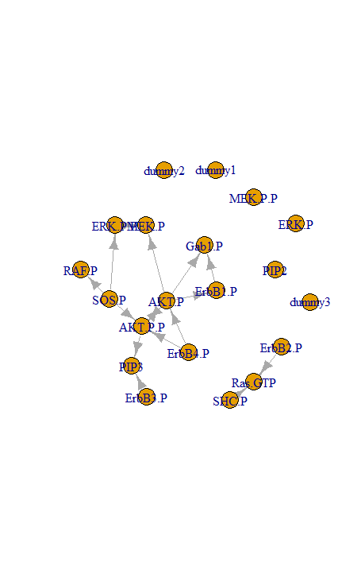
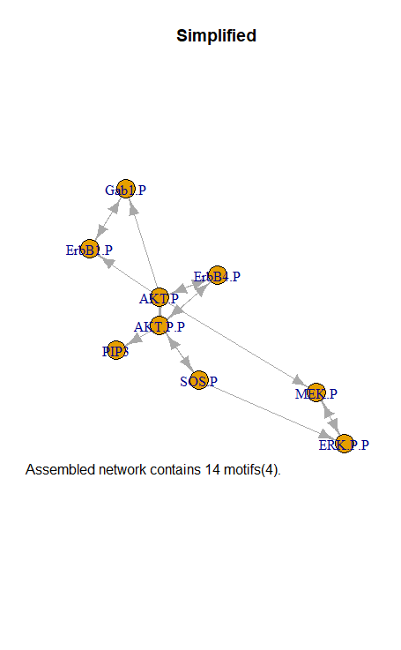
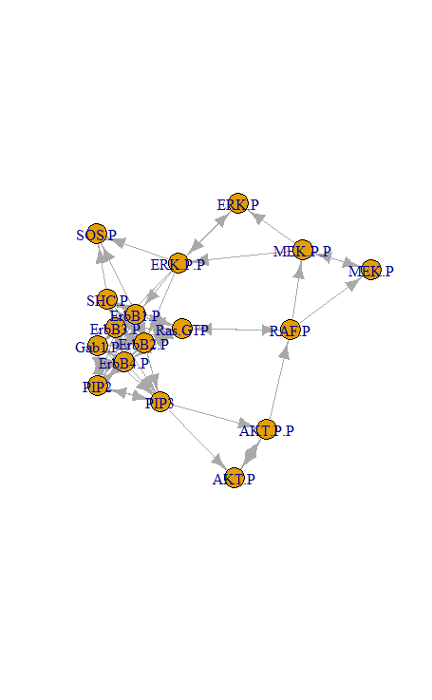
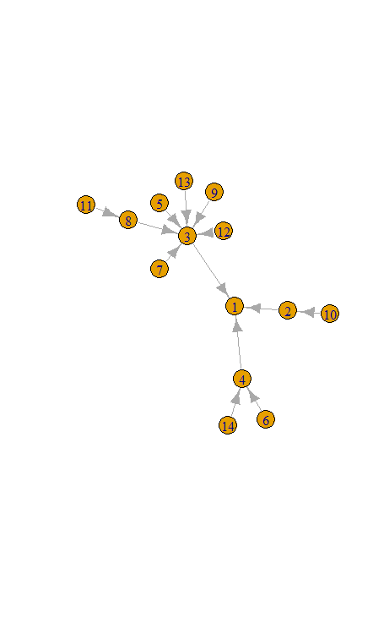
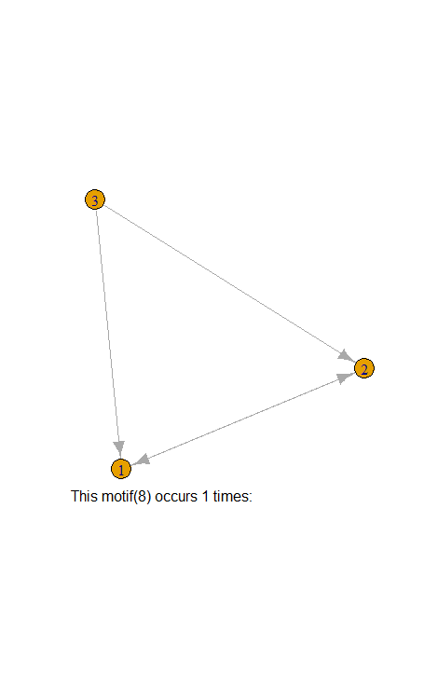
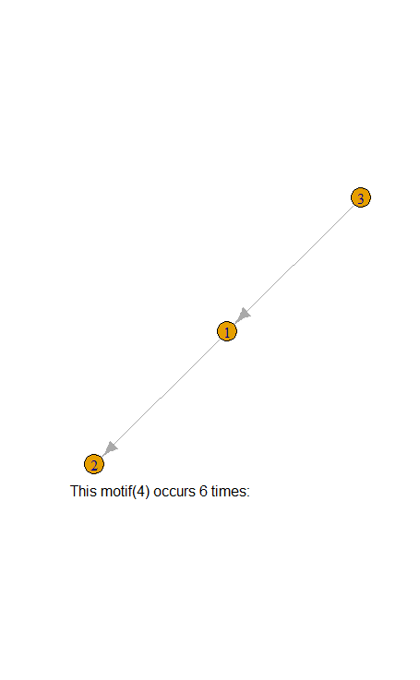
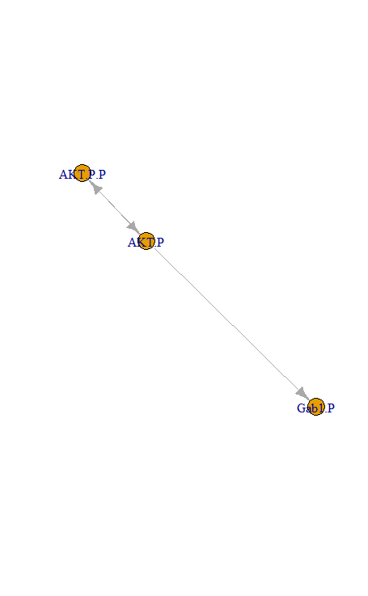
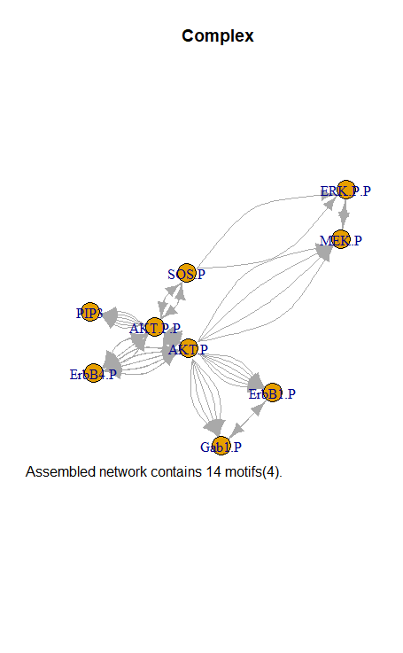
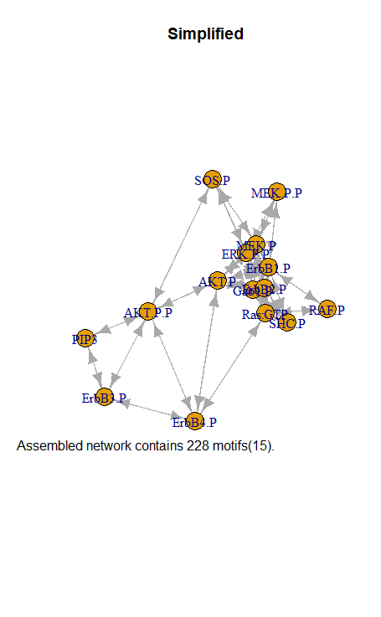
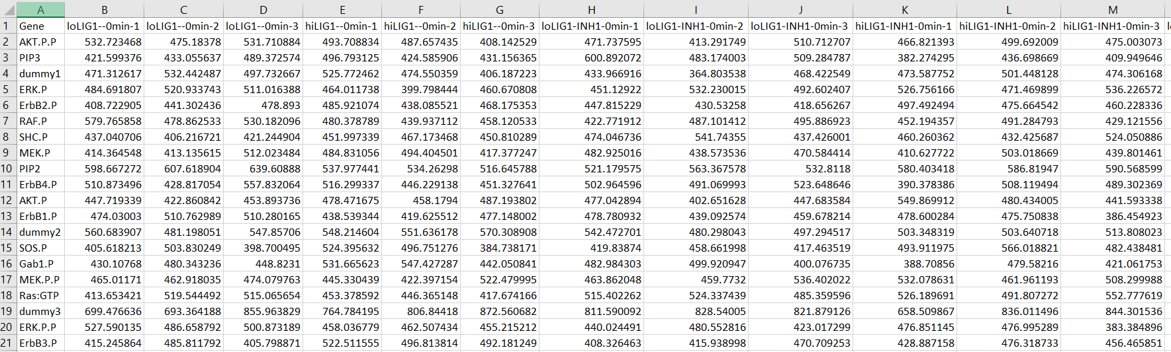
Current

Slide 4
To do
Select most ‘important’ motifs
Threshold
Assemble (ensemble knowledge)
Merge
Compare to true network
Report on match, missing and mismatch

